Slide 1
Ali Al-Saifi IEEE President Marim Elhanafy IEEE VP
المشاريع الكهربائية

Slide 2
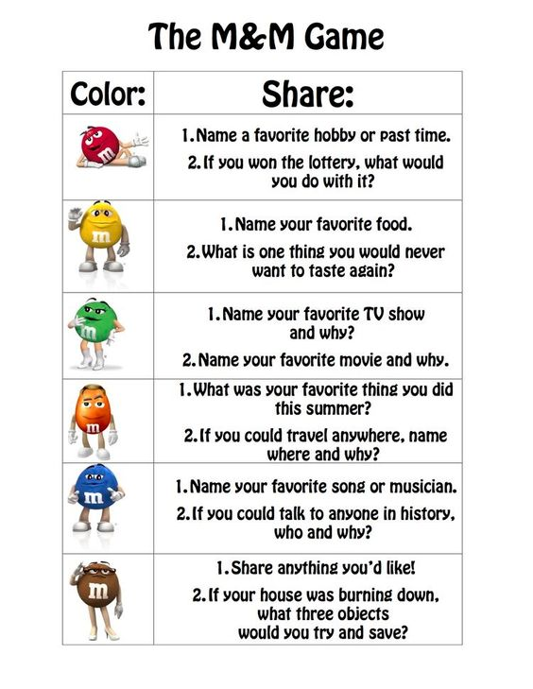

Slide 3
What is Electronics?

Slide 4
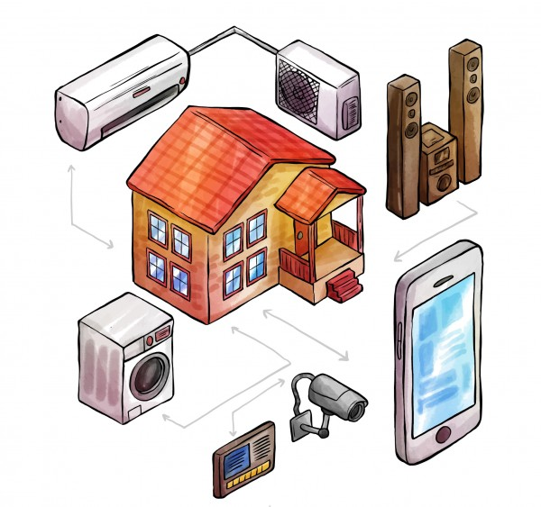
What is Electronics?
Electronics is a field of science in which we study about electric currents generated due to the movement of electric charges that flow in circuits that store and handle information, and how to control these currents.

Slide 5
Name 10 electronic device you know

Slide 6
Electronic Devices
Smartphone
Laptop
Microwave
Washing Machine
Camera
Water pump
Speaker
Projector
AC
Fridge, etc.

Slide 7
Basics of Electronics

Slide 8


Slide 9
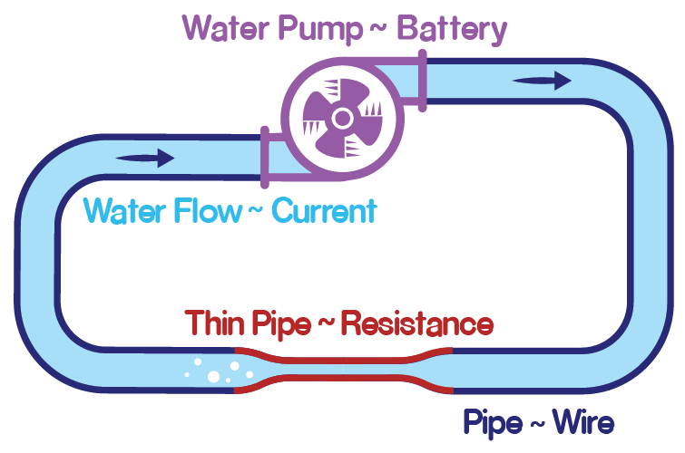
Pump Water System

Slide 10
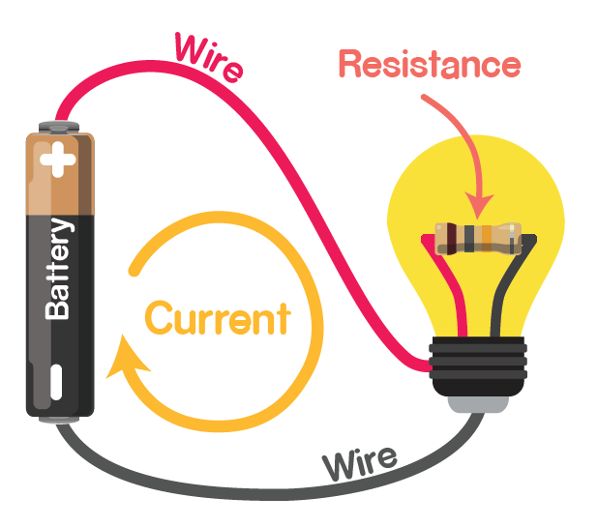
Electric Circuit
Notes:
مش للبنات
(conventional system and real system)بسبب تنافر الالكترونات مع الجزء السالب

Slide 11
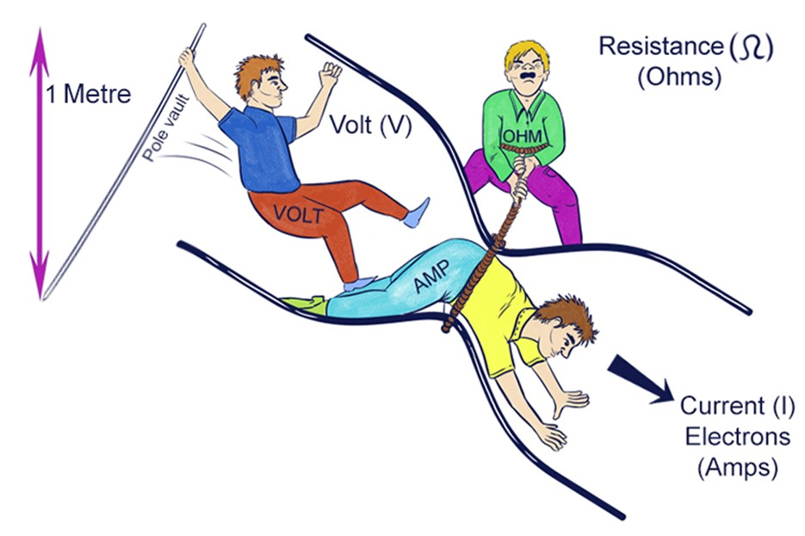

Slide 12
Revision
A circuit made of electronic components and wires is known as an electronic circuit.
Voltage is the force that a power source creates at its two ends. This force makes the charge flow around the circuit.
Battery is the power source of the circuit which provide voltage.
We measure the voltage using a device known as a voltmeter.
Polarity is the property of having two poles that have opposite physical properties – Positive & Negative
The rate of flow of charge is defined as current. Current flows from positive (higher potential) to negative (lower potential).
Current is measured in Amperes.

Slide 13
More Revision ☺
In pump water system, if we increase the pump power, water will flow through the pipe at a faster rate.
Similar thing happens in electricity, more the voltage, more the current.
The property of any material to resist the flow of charge is called resistance.
More the resistance, slower the flow of charge i.e., lesser the current.
Resistance is measured in Ohms.

Slide 14
Units and Symbols
Units are required to quantify any quantity, like length.
How tall are you? You tell it by measuring your height in meters. Hence meter is the unit of length.
Symbols are used to simplify how we express anything. Like it is easy write V instead of voltage again and again.
Symbol also simplifies the equations.
Property | Symbol | Unit | Symbol
Voltage | V | Volts | V
Current | I | Ampere | A
Resistance | R | Ohm | Ω

Slide 15
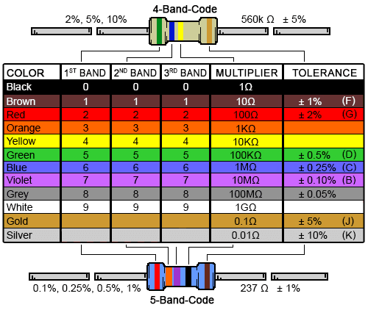
Resistor
A resistor is a passive two-terminal electrical component that implements electrical resistance as a circuit element.

Slide 16
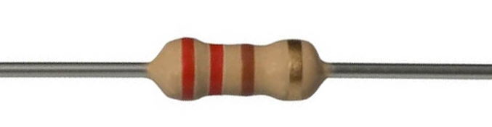
Measuring resistance of a resistor
First Band – Red, that means 2
Second Band – Red, that means 2
Multiplier – Brown, that means 10
Hence by calculation it is 22 x 10 = 220 Ohm
Tolerance Band – Gold, that means ±5% variation in the value.
Do the same for all other resistors.

Slide 17
Introduction to Transducer

Slide 18
Transducer is
a device that converts energy from one form to another.
- Usually, a transducer converts a signal in one form of energy to a signal in another.

Slide 19
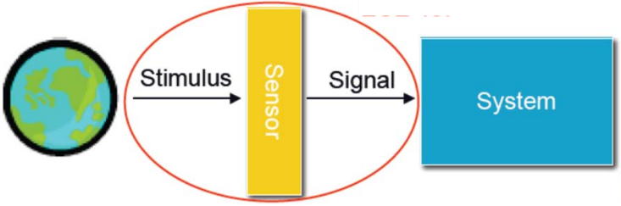
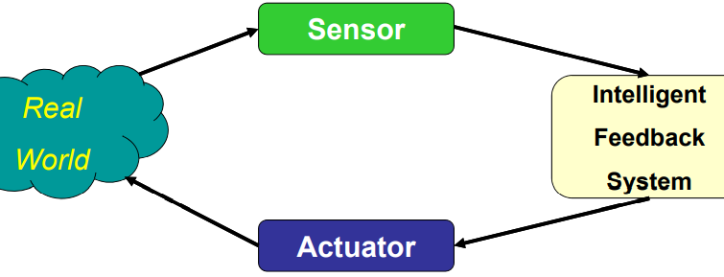
Types of Transducer:
Sensors
Actuators

Slide 20
What is Actuators?

Slide 21
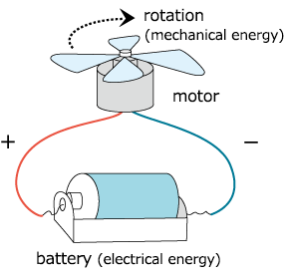
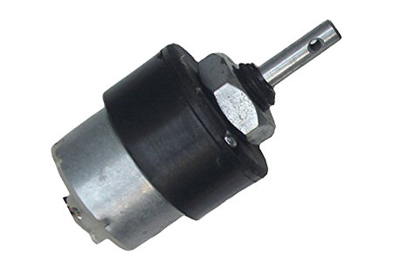
Actuators
An actuator is a mechanical device, typically a motor, that moves or controls a mechanism or another device.
In simple terms, an actuator is a mover. It helps the device move around and interact with its surrounding environment.
The actuator takes in energy – which can be obtained from either air, electricity, or a liquid – and uses this energy to help something move.

Slide 22
Types of Actuators
There are four main types of actuators:
Electrical: Electrical actuators convert electricity into rotational motion.
Mechanical: Mechanical actuators convert circular motion into linear (straight-line) motion.

Slide 23
Basics of Sensors

Slide 24
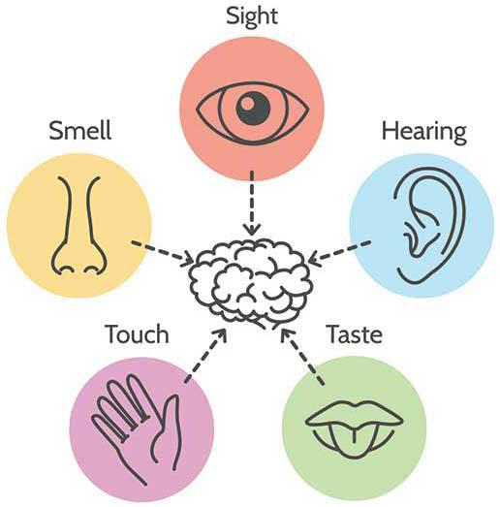
Human Senses

Slide 25
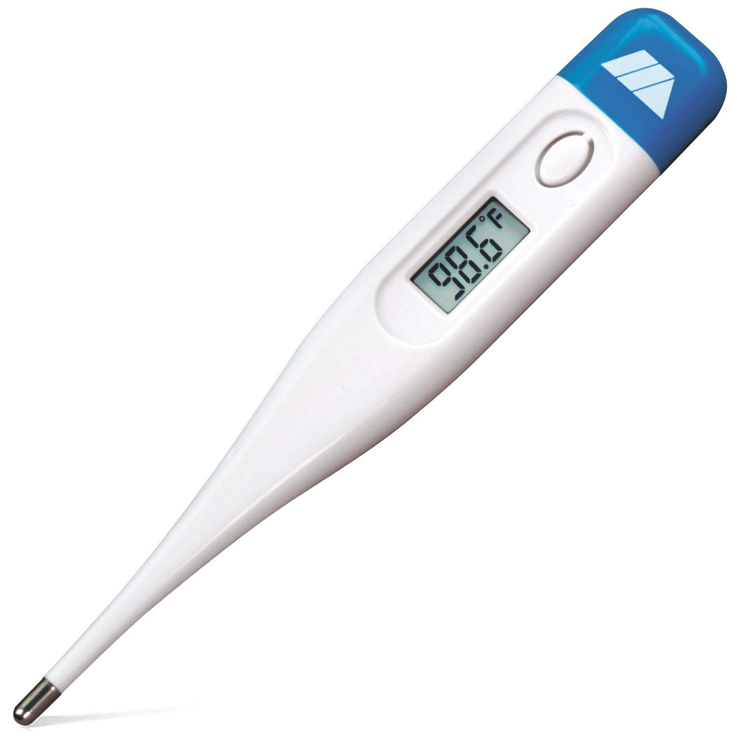
Sensors
A Sensor converts the physical parameter (for example: temperature, blood pressure, humidity, speed, etc.) into a signal which can be measured electrically.
Let’s explain the example of temperature. The mercury in the glass thermometer expands and contracts the liquid to convert the measured temperature which can be read by a viewer on the calibrated glass tube.

Slide 26
Example of sensors
Temperature sensor, e.g. thermometer
Ultrasonic sensor
Light sensor, e.g. LDR
Force sensor
Many more
Notes:
بيدينا مقدار القوة اللي بنضغط بيها عالسنسور

Slide 27
Classification of Sensor
Digital Sensor - Sensors that gives output in either in HIGH or LOW are digital signal. Usually, they have only two states or two voltage reading.
Example: IR Sensor
Analog Sensor – Sensors that gives output in a given voltage range are known as analog sensors.
Example: Light Dependent Resistors
Notes:
بيدينا قراءة مستمرة / بيدينا صفر وواحد

Slide 28
What is an Electric System?

Slide 29
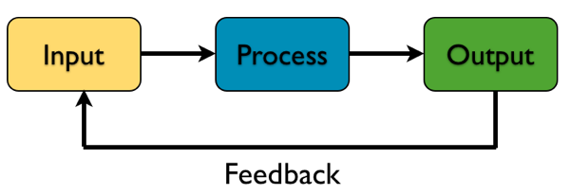
Electric System

Slide 30
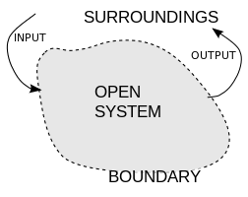
Electric System
Question:
Draw a system that represent your project.

Slide 31
What could represent a system?

Slide 32
Microcontrollers

Slide 33
Microcontroller Unit (MCU)
A microcontroller is a small, low-power computer that can be used to control various devices and systems.
It is a type of integrated circuit that contains a processor, memory, and input/output peripherals, all on a single chip.
Microcontrollers are often used in consumer electronics, automotive systems, and industrial control systems.
They are designed to be easy to program and operate, making them a good choice for use in educational projects and for teaching kids about computer science and engineering.

Slide 34
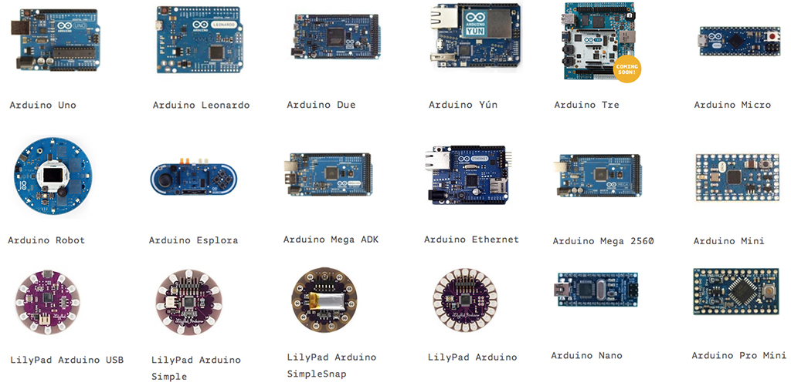
Types of Microcontrollers

Slide 35

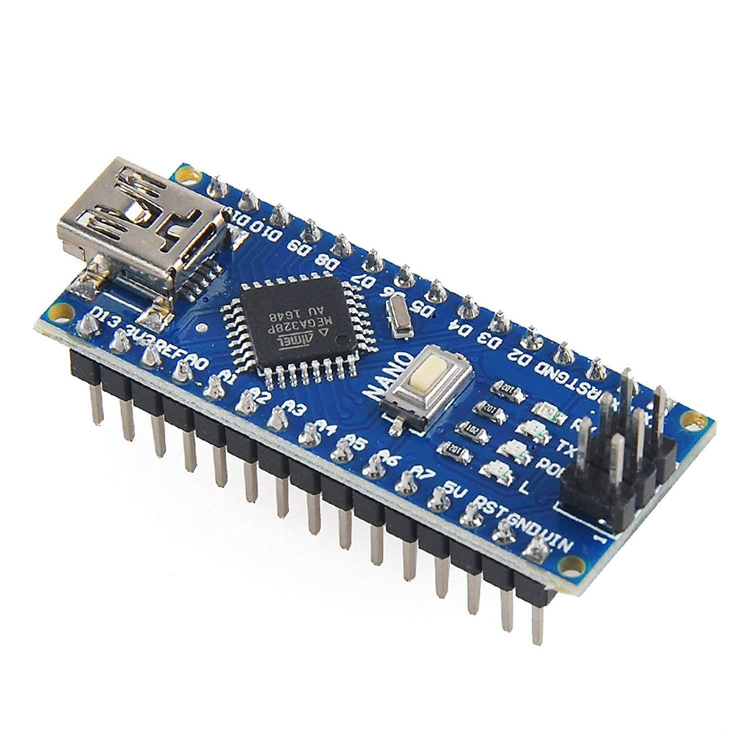
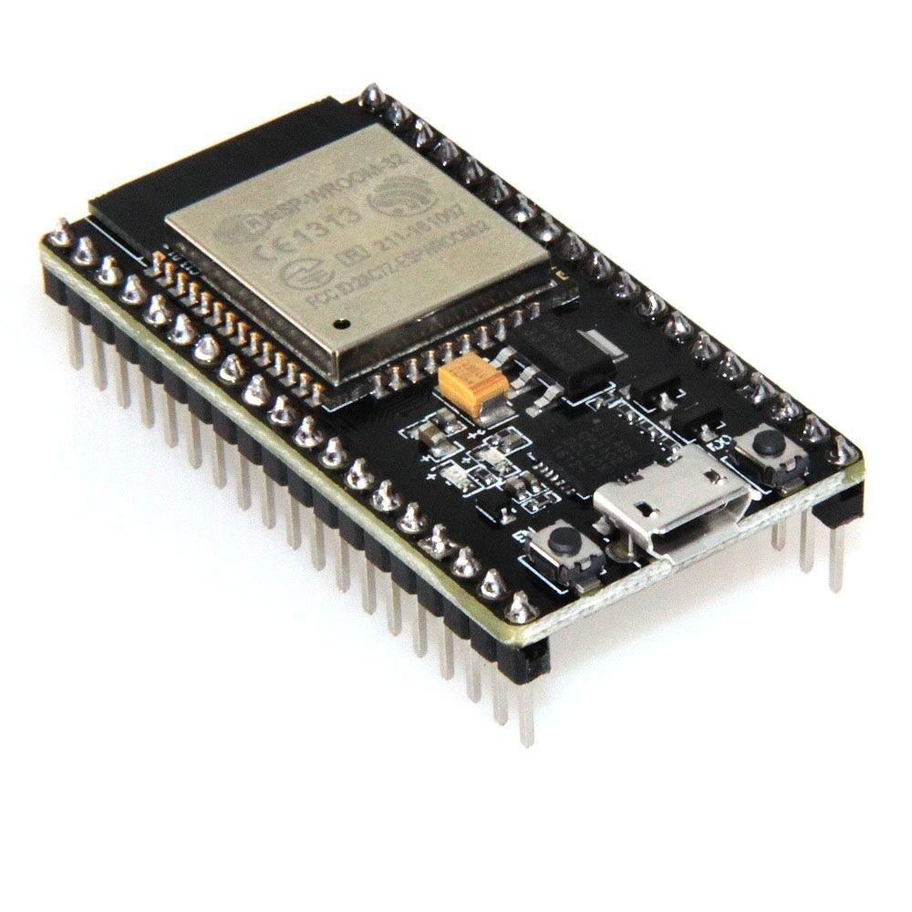
Types of Microcontrollers
Arduino NANO
Arduino UNO
ESP-WROOM-32
Notes:
اخترنا الاونو مثلا لان السنسور محتاج 5 فولت

Slide 36
How do Microcontrollers work?

Slide 37
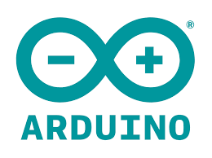
Arduino IDE
The Arduino Integrated Development Environment (IDE) is a software program that allows users to write and upload code to some microcontroller boards.
It provides an easy-to-use interface for creating, editing, and debugging Arduino sketches, which are programs written in the C++ programming language.
Software | Arduino

Slide 38
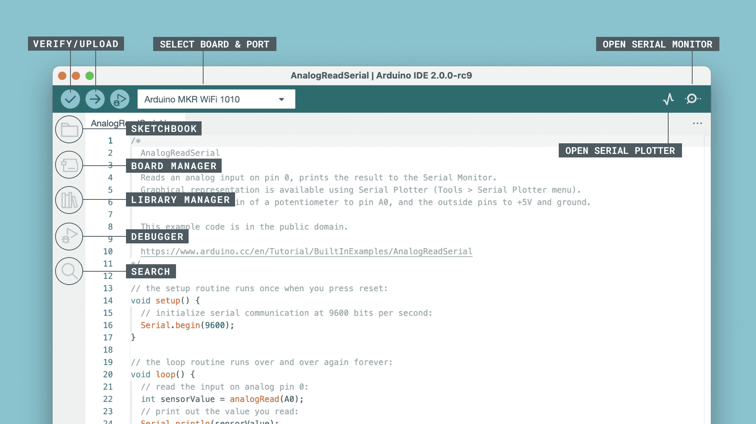

Slide 39
What if we do not have the hardware components?

Slide 40
In terms of simulators, both Tikercad and Wokwi allows users manually add components and connect them to a selected development board.
Wokwi - Online Arduino and ESP32 Simulator

Slide 41
Wokwi main features:
The interface is intuitive and easy to use.
Simulation speed is convenient.
It includes Virtual Logic Analyzer to capture digital signals in your simulation (e.g., UART, I2C, SPI) and analyze them on your computer.
It supports various MCU development boards such as the ESP32, Arduino UNO, Arduino Mega, Raspberry Pi Pico, and ATTiny85.
You do not need to install any software IDE on your computer. It supports both Arduino and MicroPython programming languages.

Slide 42
How will Microcontrollers transmit and receive data?

Slide 43
I2C Protocol

Slide 44
I2C (Inter-Integrated Circuit)
The I2C protocol is a communication standard that allows devices to exchange data with each other over a two-wire interface.
It is commonly used in embedded systems, such as smartphones and other consumer electronics, to connect various sensors and peripherals to a microcontroller.
The I2C protocol uses a unique addressing scheme to identify each device on the bus, allowing multiple devices to communicate with each other and with the microcontroller.

Slide 45
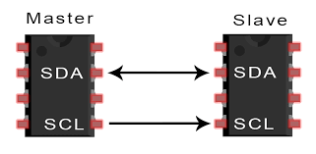
I2C (Inter-Integrated Circuit)
Notes:
واحد بيبعت الداتا او البيانات والمعلومات والثاني بيزبط التوقيت
الماستر هو متحكِم والسليف هو المتحكَم به
الماستر عندنا هو المايكروكونترولر

Slide 46
HW
Implement the code of this circuit.

Slide 47
How to start my project?

Slide 48
What are the project design steps?

Slide 49
Steps:
List the needed components
Implement the Circuit Diagram:
Consider the following:
MCU Pin Configuration
Wiring Coloring
Hardware Implementation
Coding
Testing

Slide 50
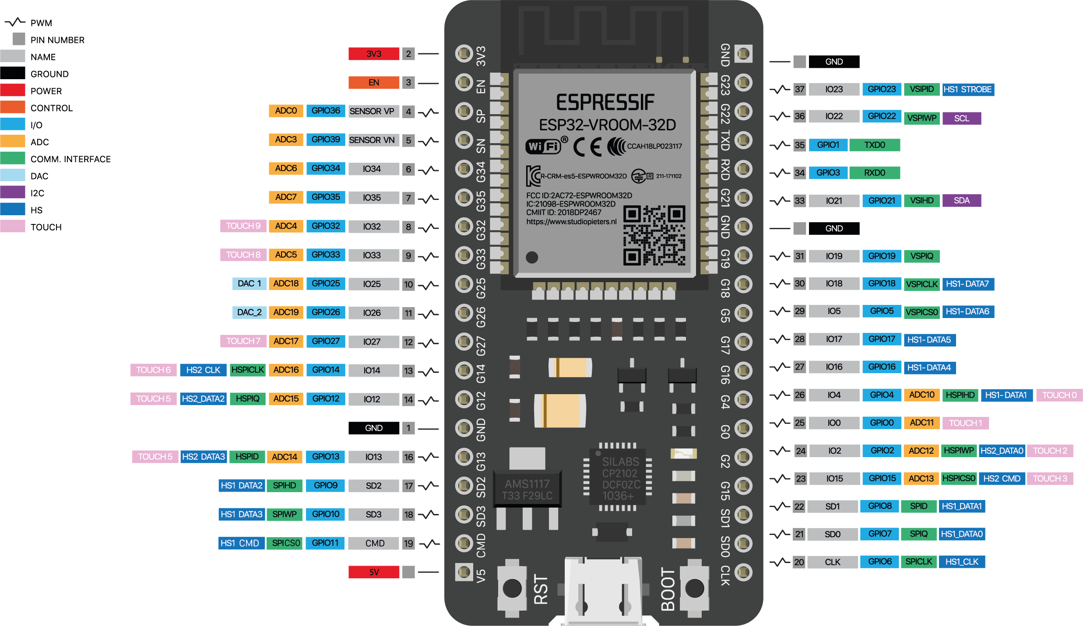
MCU Pinout

Slide 51
Now Let's implement the projects

Slide 52


Slide 53
Installing the ESP32 Board in Arduino IDE (Windows, Mac OS X, Linux)
Installing ESP32 in Arduino IDE (Windows, Mac OS X, Linux) | Random Nerd Tutorials

